Slide 1
City of Atascadero
Consideration of Sales Tax
Measure
City Council
May 26, 2020
To participate in tonight’s meeting, please call 805-538-2888
Notes:
Ms. Mayor and Council members, the item you have before you is the 2018/2019 Audited financial statement report

Slide 2
Background
The City is a poorly funded City with underlying structural financial challenges
Since incorporation the City has looked to various solutions
January 2019- Council adopted fiscal sustainability as one of its top 3 priority areas
May 2019- Adopted action plan including action to investigate placing a sales tax on the ballot

Slide 3
Background
November 2019- Hired True North Research to conduct a statistically valid poll of likely voters
January 2020- Poll was conducted
February 2020- “Top Line” results were reviewed at Mid-Cycle Update Council meeting
March 2020- True North Research presented polling results to Council. 65% of selected persons polled stated they would vote yes on a one cent sales tax measure

Slide 4
Sales Tax
State rate is 7.25% of gross taxable sales.
  State gets 6.25%
  City where sales tax place gets 1%
  Complex formulas to determine where sale takes place on internet, deliveries and installations
  Voters may approve additional sales tax
  California rates between 7.25% to 10.5%

Slide 5
Sales Tax
State tax is not imposed on:
  Groceries
  Medications
  Utilities
  Services
  Real Estate / Rent / Mortgages

Slide 6
Sales Tax
Additional sales tax would be imposed on purchases made in the City of Atascadero
  Gas
  Cleaning Products / Paper Products etc…
  Building Materials
  Restaurants
  Additional sales tax would be imposed on “outside” purchases of:
  Cars registered in Atascadero
  Amazon sales

Slide 7
Sales Tax Measures
Council can decide to put a sales tax measure on the November ballot voters with a 4/5 vote
Council can NOT impose a sales tax- only place it on the ballot
Must be placed on a ballot where Councilmembers are selected (November of even years)
If passed in November- goes into effect April 1, 2021
General tax requires 50% +1 vote to pass
Special tax requires 2/3rd + 1 vote to pass

Slide 8
Proposed Language
To provide funding for fire protection, paramedics, and 911 emergency response, police, crime prevention and investigations, maintenance of parks, public facilities and infrastructure, graffiti removal, and recreation, community services, and other general city services in the City of Atascadero, shall the measure establishing a one-percent sales tax be adopted, providing approximately $4.5 million dollars annually for city services until ended by voters, with annual independent audits and all money locally controlled?

Slide 9
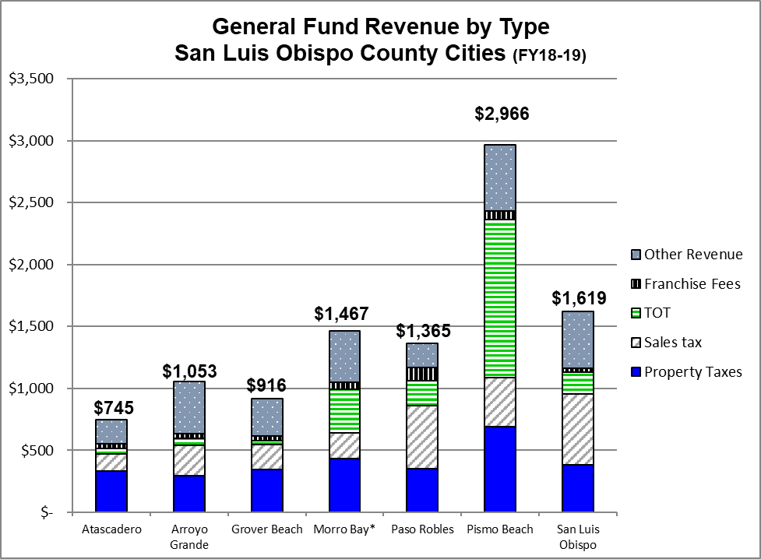
Why Consider a Sales Tax Measure? - Low Revenue City

Slide 10
Why Consider a Sales Tax Measure? - Low Revenue City

Slide 11
Why Consider a Sales Tax Measure? - Low Revenue City

Slide 12
Why Consider a Sales Tax Measure? – Cost Cutting
Atascadero
State Avg.
Cost per
Cost per
% of State
Capita
Capita
Avg.
Police
$
240.00
$
677.00
35.5%
Fire
$
153.00
$
807.00
19.0%
Community Development
$
104.00
$
539.00
19.3%
Parks & Recreation
$
56.00
$
100.00
56.0%
Streets
$
39.00
$
432.00
9.0%
General Government
$
48.00
$
504.00
9.5%
Notes:
This inequity forces the City to manage resources in a fiscally responsible manner, consistently protecting and stretching our taxpayer’s dollars as far as possible. While the City does as much as it can, for as many as it can, as often as it can, unfortunately there is still much to be done and no funding available to do so.
This is a chart that was shared during on Talk on the Block presentations with data from Cleargov.com. IT shows when compared to other cities across the State of California the City spends a fraction of the state average in all categories. That is good. It means that we are cost effective, what it doesn’t show is how we do that and why it is not sustainable in the long-run

Slide 13
Artificially Low Costs
Four areas where the City is unsustainably keeping costs down:
    Fewer employees
    Paying employees less
    Deferring repairs and replacement of infrastructure
    Lower service levels

Slide 14
Fewer Employees

Slide 15
Fewer Employees
3 police officers on duty

Slide 16
Paying Employees Less
Notes:
This is just salary and there are benefit differences, but the City is also amongst the lowest if not the lowest in the County
That is cost effective right? Well maybe not
Use police officer example
Hard to hire throughout state
Continually lose officers to other local jurisdiction
Very hard to hire laterals- from other jurisdictions- hard throughout state and we are low paying high cost of living
City uses a recruit program effectively-but hiring process, background, 6 month academy, 4 month field training- at best new unseasoned police officer on the street in a year. In the meantime- existing officers work short staffed for the entire year and in the end- nothing prevents the new officer from leaving when another opening in the County
While more pronounced or perhaps easier to understand in Police- it’s the same throughout the City What it means is that we are consistently short staffed, training and have unseasoned staff- which is exceptionally tough when you are doing it with fewer employees to begin with

Slide 17
Deterioration of Infrastructure
Parks
Buildings
Roads
Vehicles
Equipment
Computers

Slide 18
Deterioration of Infrastructure
Fire Station #1- 70 years old. $9.3 million construction cost to renovate
Fire Engines- Aging $500,000 each to replace
Tractors, backhoes, dump trucks
Fire and paramedic equipment- cardiac monitors, breathing apparatus, etc
Park facilities
Roads

Slide 19
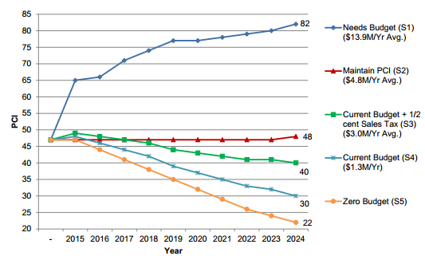
Deterioration of Infrastructure
Insert road PCI chart

Slide 20
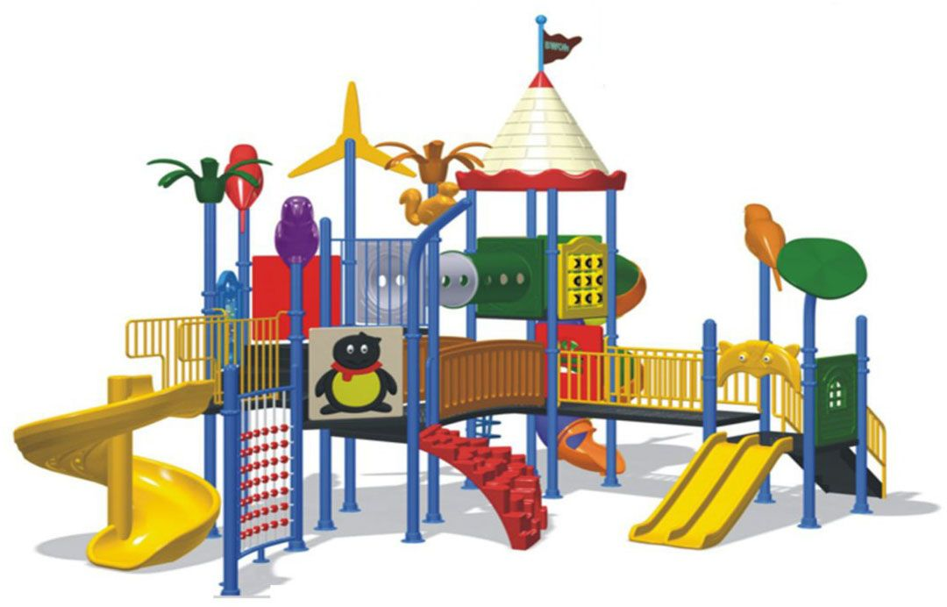



Level of Service

Slide 21
Arguments For:
Everyone pays- travelers, tourists, business and residents
  Paid based on consumption- those that buy little pay little and those that buy a lot pay more
  Can’t be taken by State
  Not paid on basic necessities
  Additional revenue is necessary to maintain police, fire, parks and other services
  Other jurisdictions in County

Slide 22
Arguments Against:
Certain residents can’t afford any new taxes
COVID-19 has had a financial impact on some in our community
This is a general tax and there is no guarantee on how the additional revenue will be spent

Slide 23
Proposed Language
To provide funding for fire protection, paramedics, and 911 emergency response, police, crime prevention and investigations, maintenance of parks, public facilities and infrastructure, graffiti removal, and recreation, community services, and other general city services in the City of Atascadero, shall the measure establishing a one-percent sales tax be adopted, providing approximately $4.5 million dollars annually for city services until ended by voters, with annual independent audits and all money locally controlled?

Slide 24
Sales Tax Options to be considered
Amount of Increase
Sunset Clause
Citizen Advisory Committee
Citizen Oversight Committee
Other Transparency or Accountability Measures

Slide 25
Recommendation
Direct staff to prepare a resolution and ordinance for City Council consideration at the July 14, 2020 meeting to place a one cent local sales tax override measure on the November 2018 ballot; and,
Provide staff direction on what should be included in the draft ordinance.

Slide 26
Questions

