Slide 1
City of Atascadero Consideration of Sales Tax Measure
City Council
July 14, 2020
To participate in tonight’s meeting, please call 805-538-2888
Notes:
Ms. Mayor and Council members, the item you have before you is for placement of a sales tax measure on the ballot for the November 3, 2020 Election.

Slide 2
Background
The City is a poorly funded City with underlying structural financial challenges
Since incorporation the City has looked to various solutions
City seeks to maintain essential services and cannot sustain the services it provides with the projected available resources
May 26, 2020 Meeting Council directed staff to prepare necessary legislation for Council consideration for placement of a one cent sales tax override measure on the ballot

Slide 3
Sales Tax Measures
Council can decide to put a sales tax measure on the November ballot voters with a 4/5 vote
Council can NOT impose a sales tax- only place it on the ballot
Must be placed on a ballot where Councilmembers are selected (November of even years)
If passed in November- goes into effect April 1, 2021
General tax requires 50% +1 vote to pass

Slide 4
Sales Tax Measures Cont.
Council must adopt ordinance detailing measure before submitted to voters on election day
Resolution Nos. 2020-051 and 2020-052 initiating election process and consolidating with County previously adopted
Draft Resolution A required to clarify ballot language and place measure on ballot
Draft Resolutions B sets priorities for filing of written arguments, authorize Council Members to write arguments
Draft Resolution C allows for rebuttals

Slide 5
Proposed Language
To provide funding for fire protection, paramedics, and 911 emergency response, police, crime prevention and investigations, maintenance of parks, public facilities and infrastructure, graffiti removal, and recreation, community services, and other general city services in the City of Atascadero, shall an ordinance establishing a one-percent sales tax be adopted, providing approximately 4.5 million dollars annually for city services until ended by voters, with annual independent audits and all money locally controlled?

Slide 6
Ballot Measure – Election Requirements
City Attorney’s Impartial Analysis
500 word maximum
Written Arguments for and against
300 word maximum
Deadline of July , 2020 (10 days)
Rebuttal Arguments
250 word maximum
Deadline of August 3, 2020 (10 more days)
Arguments must have signatures of authors (no more than 5)

Slide 7
Election Requirements Cont.
California Elections Code:
If more than one argument in favor and one argument opposed is submitted, the City Clerk must select one of each for printing and distribution to the voters, based on criteria in the Elections Code.
Resolution A requires 4/5 votes by Council for placement on ballot

Slide 8
Election Costs
Election - $40,700
Sales Tax Ballot Measure - $12,000
TOTAL ESTIMATE = $52,700

Slide 9
Recommendations
Introduce, on first reading by title only, Draft Ordinance amending Title 3 of the Atascadero Municipal Code to add a Chapter 18 “Essential Services Transactions and Use Tax” to be administered by the California Department of Tax and Administration, subject to adoption by the electorate.

Slide 10
Recommendations cont.
Adopt the following Resolutions to submit to the voters a question relating to increased sales tax:
Draft Resolution A, approving ballot measure text relating to increased sales tax to be submitted to the qualified electors of the City at the General Municipal Election to be held on November 3, 2020, as called by Resolution No. 2020-051.
Draft Resolution B, setting priorities for filing written arguments regarding the City measure and directing the City Attorney to prepare an impartial analysis.
Draft Resolution C, providing for the filing of rebuttal arguments for City measures submitted at Municipal Elections.

Slide 11
Recommendations cont.
Authorize the Director of Administrative Services to appropriate $12,200 of General Fund Reserve monies to the City Clerk budget.

Slide 12
Questions

Slide 13
Revised Ballot Language
To provide funding for fire protection, paramedics, and 911 emergency response, police, crime prevention and investigations, maintenance of parks, public facilities and infrastructure, graffiti removal, and recreation, community services, and other general city services in the City of Atascadero, shall an ordinance establishing a one-percent sales tax be adopted, providing approximately 4.5 million dollars annually for city services until ended by voters, with annual independent audits ensuring money is spent properly, and all money locally controlled?

Slide 14
Revised Ordinance Language
WHEREAS, one of the two fire stations protecting lives and property within the City’s approximately 26 square miles was built in 1951 and has critical safety deficits requiring replacement; and
WHEREAS, the City, has approximately half the national average of police officers per capita for a City its size, is amongst the lowest paying City employer in the County for most positions, and has deteriorating infrastructure including fire stations, parks, roads, sidewalks, zoo facilities and other buildings; and

Slide 15
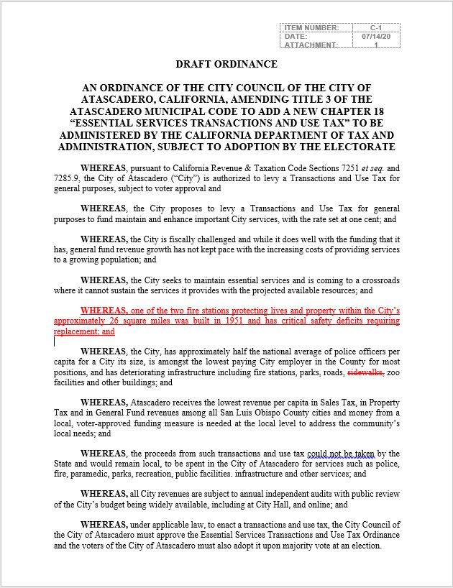
Revised Ordinance Language

